Slide 1

Testing OrangeHRM Demo Website: Manual & Automation Insights
Team 3
Youssef Zaafan
Mariana Shawky
Ahmed Sayed

Slide 2

Introduction: Why OrangeHRM Demo?
Open-source HR management system widely used for testing practice.
URL: https://opensource-demo.orangehrmlive.com/web/index.php/admin/viewSystemUsers
Covers critical HR modules: Admin, PIM, Leave, My Info, Login/Logout.
Ideal for validating both manual and automated testing strategies.

Slide 3
User Stories Overview: Core Functionalities Tested
Login & Logout
Admin
PIM (Personal Information Management)
Secure access and session management for all users.
Comprehensive user management and role assignments.
Efficient handling and storage of all employee personal data and add new employees
My Info
Leave
Employee self-service portal for updating personal profiles and information.
Streamlined leave application and approval workflows for employees and managers.

Slide 4
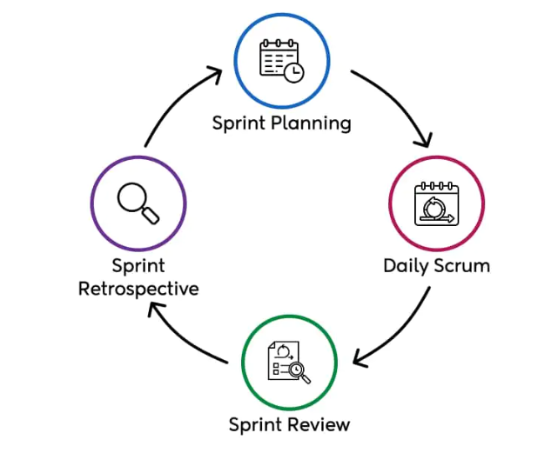
Planning Meetings
Trello Board

Slide 5

Comprehensive Testing Approach
Our testing strategy combined both manual and automated methods to ensure robust coverage and reliability of the OrangeHRM system.

Slide 6
Environments of testing:
Desktop Environment
Mobile Environment
OS: Windows 10 Pro | OS: Windows 10 Pro
Platform: Google Chrome | Platform: Firefox
Version: 142.0.7444.176 (Official Build) (64-bit) | Version: Version 144.0.2 (64-bit)
OS: iOS | OS: Android
Platform: Safari | Platform: Google Chrome
Version: iOS 26.1 | Version: android 14

Slide 7
Admin: Manual Testing Process
01
02
Read User Story
Generate Test Scenarios
Thoroughly understand the requirements and expected behavior of the Admin module.
Identify various paths and conditions for testing the Admin functionalities.
03
04
Write Test Cases
Execute Test Cases
Develop detailed, step-by-step instructions for executing tests, including expected results.
Perform the written test cases, meticulously documenting results and any defects found.

Slide 8
Admin: Automation Testing Process
Implement Admin Page with Methods
Select Test Cases with Mix & Match Methodology
Develop page object models and utility methods for interacting with Admin elements.
Prioritize and select a diverse set of test cases suitable for automation, combining critical and edge scenarios.
Implement Admin Tests
Implement Data Provider
Translate selected manual test cases into executable automation scripts using a chosen framework.
Create data-driven tests to execute the same test logic with multiple sets of input data, enhancing coverage and efficiency.

Slide 9
Challenges & Solutions
Dynamic Elements
Complex Workflows
Employee Name Field Restriction
Challenge: Flaky automation tests due to frequently changing web elements.
Challenge: Intricate leave approval workflows involving multiple user roles.
Challenge: The employee name field had unexpected restrictions and behaviors.
Solution: Implemented explicit waits to ensure stability of locators.
Solution: Designed modular test scripts with a data-driven approach to cover all scenarios.
Solution: Implemented a method to retrieve the current username for dynamic input, ensuring test validity.

Slide 10
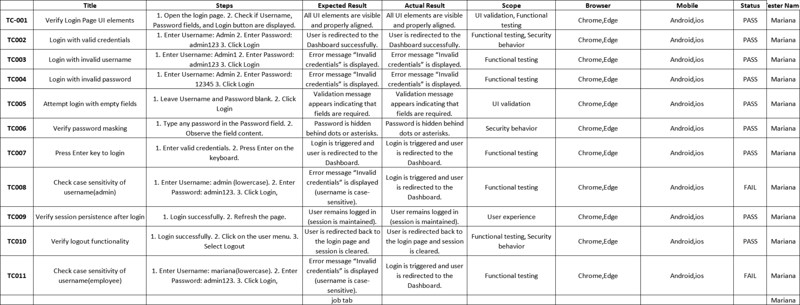
Login & Logout: User Story
User Story: As a user, I want to securely log into and out of the OrangeHRM system to access my HR information and maintain session security.
Acceptance Criteria:
Valid users can log in with correct credentials
Invalid login attempts are properly handled
Users can safely log out and end their session
Login page is accessible and user-friendly

Slide 11

Login & Logout: Manual Testing Approach
Manual Testing Process:
Test Case Design
Execution Strategy
Created comprehensive test scenarios covering valid/invalid credentials and security aspects
Systematic testing of all login/logout combinations with different user roles
Validation Points
Documentation
Verified proper error messages, session timeouts, and security measures
Recorded all test results, defects, and observations for future reference
Key Manual Test Areas:
Valid credential combinations
Invalid username/password scenarios
Logout functionality verification
Security error handling

Slide 12




Login & Logout: Automation Testing Approach
Automation Implementation:
Implementation
Test Coverage
Benefits Achieved
Page Object Model: Created LoginPage class with methods for login/logout actions
Automated valid login scenarios
Faster regression testing
Test Framework: Used Selenium WebDriver with TestNG for structured test execution
Invalid credential testing with data providers
Consistent test execution
Data-Driven Testing: Implemented data providers for multiple credential combinations
Logout functionality automation
Improved test coverage
Assertions: Added comprehensive validations for successful/failed login attempts
Cross-browser compatibility testing
Reduced manual effort

Slide 13

Login & Logout: Challenges & Solutions
Key Challenges Faced:
Browser Compatibility Issues
1
Problem: Different browsers handled login redirects differently
Solution: Created browser-specific handling methods and cross-browser test suites
Security Error Messages
2
Problem: Inconsistent error message formats for different failure scenarios
Solution: Used flexible assertion methods that check for key error indicators rather than exact text matches
Test Data Management
3
Problem: Managing multiple user credentials and test data sets
Solution: Implemented external data files and data provider methods for clean test data management

Slide 14
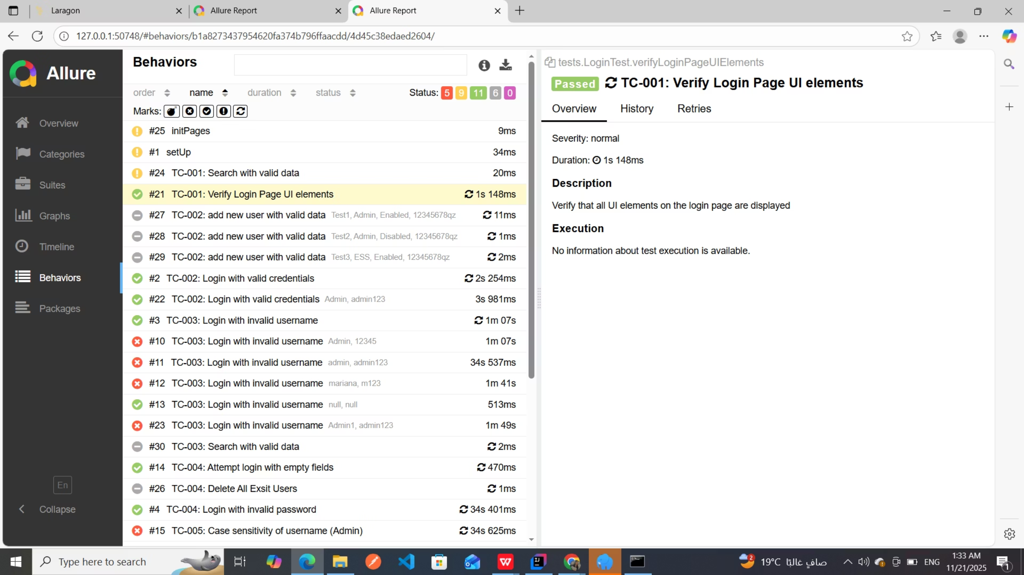
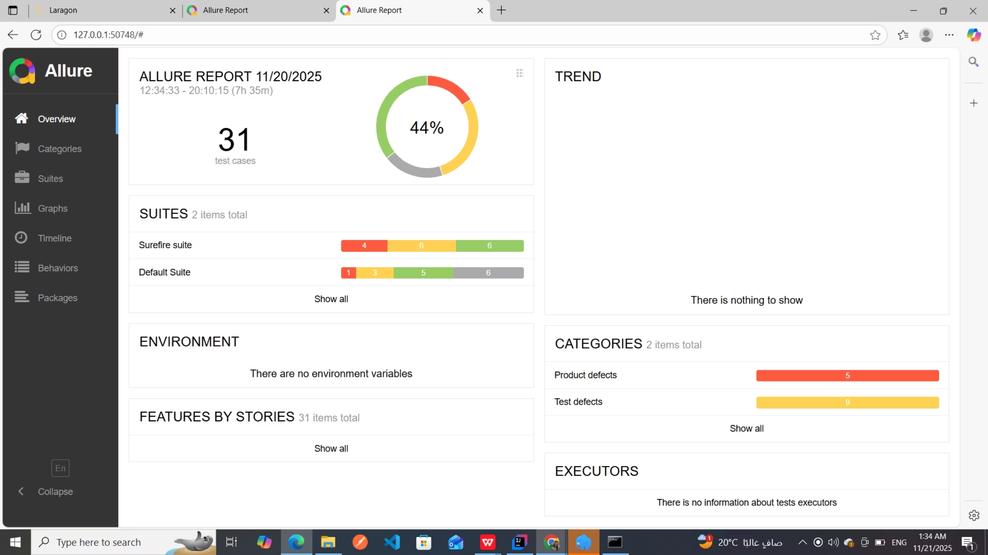
Overall Test Results & Reports
Our comprehensive testing approach covered the entire OrangeHRM system, yielding detailed results and comprehensive reporting through the Allure framework.
Key Achievements:
31 Test Cases Executed with 44% pass rate in initial run
Comprehensive Test Coverage across all OrangeHRM modules (Admin, PIM, Leave, My Info, Login/Logout)
Detailed Reporting with categorized results and trend analysis
Environment Validation ensuring consistent test execution
Defect Tracking with clear categorization and priority levels
Test Categories Covered:
Product Defects
Test Defects
No Defects
Critical functionality issues across all modules
Framework and test script improvements needed
Successfully validated scenarios

Slide 15
PIM: Manual Testing Process
01
02
Read User Story
Generate Test Scenarios
Detailed study for PIM Module including check employee's data and adding new employees
Identify various required data for each employee and mandatory fields
03
04
Write Test Cases
Execute Test Cases
Develop detailed, step-by-step instructions for executing tests, including expected results.
Perform the written test cases, meticulously documenting results and any defects found.

Slide 16
PIM: Automation Testing Process
Implement PIM Page with Methods
Select Test Cases with Mix & Match Methodology
Develop page object models and effective methods for interacting with Employee list & Add Employee
Select various automated test cases which can meet our approach
Implement PIM Tests
Translate selected manual test cases into executable automation scripts using a chosen framework.

Slide 17

Overall Testing Outcomes
Our combined manual and automation testing efforts resulted in high-quality software, identifying and resolving key issues across all critical HR modules. We achieved significant improvements in system stability and user experience.

